Slide 1

Risk Prediction For Traumatic Brain Injury Stroke Using Kernel Extreme Learning Machine and Neutrosophic C-means-based Attribute Weighting Algorithm
SRM INSTITUTE OF SCIENCE AND TECHNOLOGY
SCHOOL OF COMPUTING
DEPARTMENT OF COMPUTING TECHNOLOGIES
18CSP107L / 18CSP108L - MINOR PROJECT / INTERNSHIP
Batch ID: B373
Student 1 Reg. No: RA2011003010172
Student 1 Name: NIVETHA SANKARASUBRAMANIAN
Student 2 Reg. No: RA2011003010152
Student 2 Name: PRAVEEN KRISHNAKANTH S
Guide name: Dr . D.Shiny Irene
Designation: Assistant Professor Department: CTECH

Slide 2
ABSTRACT
The project employs innovative machine learning techniques, enhancing the accuracy of brain stroke detection. This innovation contributes to more precise diagnosis and timely intervention.
The project addresses limitations in the existing healthcare system, specifically focusing on reducing the occurrence of false positives and false negatives in stroke detection.
With a user-friendly interface, the project empowers individuals to assess their own stroke risk, promoting proactive health management.
This analysis enhances stroke detection accuracy and sets a new standard for efficient, secure, and patient-centric medical technology solutions.

Slide 3
PROBLEM STATEMENT
Efficient and accurate brain stroke detection is critical for minimizing the morbidity and mortality associated with this condition. However, existing diagnostic methods face challenges in terms of accessibility, accuracy, and early detection.
Early Detection: Develop advanced diagnostic systems capable of identifying strokes at their earliest stages to enable prompt medical intervention and reduce long-term neurological damage.
Improved Accessibility: Enhance accessibility to stroke diagnosis and treatment, especially in underserved areas, through telemedicine and telestroke networks connecting remote healthcare facilities with stroke specialists. Additionally, focus on creating wearable devices and continuous monitoring systems to improve accessibility and timely intervention.

Slide 4
OBJECTIVES OF THE PROJECT
The objectives of a project on brain stroke detection analysis are as follows :
Enhance Early Detection: Develop and implement an accurate and efficient brain stroke detection system that can identify strokes at an early stage, leading to timely medical intervention and improved patient outcomes.
Improve Diagnostic Accuracy: Enhance the precision of brain stroke diagnosis by leveraging comprehensive health data and advanced artificial intelligence algorithms. This will help in reducing the incidence of false positives and false negatives during the detection process, contributing to more reliable stroke predictions.
Facilitate Integration: Design the system with a focus on seamless integration with existing healthcare infrastructure, ensuring that it can be easily adopted into clinical workflows and used by healthcare professionals to enhance stroke diagnosis and treatment.

Slide 5
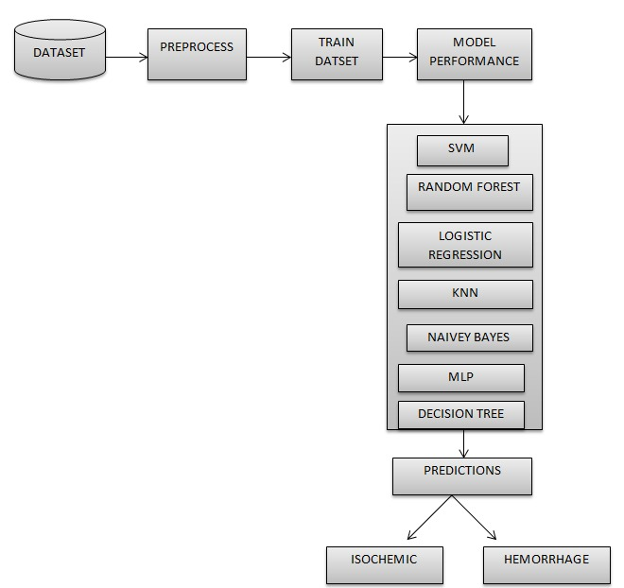
ARCHITECTURE

Slide 6
PROPOSED MODULES AND THEIR
ALGORITHM DESCRIPTION
Data Preprocessing Module:
Clean, encode, and scale the dataset for machine learning, using techniques like data imputation, label encoding, and feature scaling.
Feature Selection Module:
Identify the most relevant predictors using feature selection algorithms like Recursive Feature Elimination (RFE) and feature importance.
Machine Learning or Deep Learning Module:
Evaluate and compare various machine learning models (e.g., Logistic Regression, Naive Bayes, K-Nearest Neighbors, Support Vector Machine, Decision Tree, and Random Forest.) for brain stroke prediction
User Interface Integration:
Develop a user-friendly interface to accept health data, preprocess user input, and provide stroke risk predictions.
Reporting and Insights:
Generate user and clinician reports, including confusion matrices and visualizations, to convey prediction results and insights.

Slide 7
Brain Stroke Prediction
14-10-2023

Slide 8
TESTING/RESULT ANALYSIS

Slide 10
These text boxes and checkboxes offer transparency and insights to users by allowing them to explore the dataset, understand the data encoding process, and evaluate the performance of machine learning models within the application.

Slide 11
CONCLUSION
In summary, this project marks a significant milestone in the field of healthcare technology. By harnessing the power of advanced machine learning, we've successfully improved brain stroke diagnosis, notably reducing the frequency of misdiagnoses. Our user-friendly interface enables individuals to assess their own risk of stroke, while healthcare professionals gain valuable insights for proactive intervention. This promising advancement not only addresses longstanding challenges in stroke detection but also holds the potential to save lives, enhance patient care, and contribute to the broader landscape of medical innovation.

Slide 12
REFERENCES
https://www.frontiersin.org/files/Articles/1257591/fbioe-11-1257591-HTML-r1/image_m/fbioe-11-1257591-t001.jpg
https://www.ncbi.nlm.nih.gov/pmc/articles/PMC10000667/table/healthcare-11-00666-t001/?report=objectonly
https://www.ncbi.nlm.nih.gov/pmc/articles/PMC4276348/
https://www.ncbi.nlm.nih.gov/pmc/articles/PMC8271462/

